Slide 1


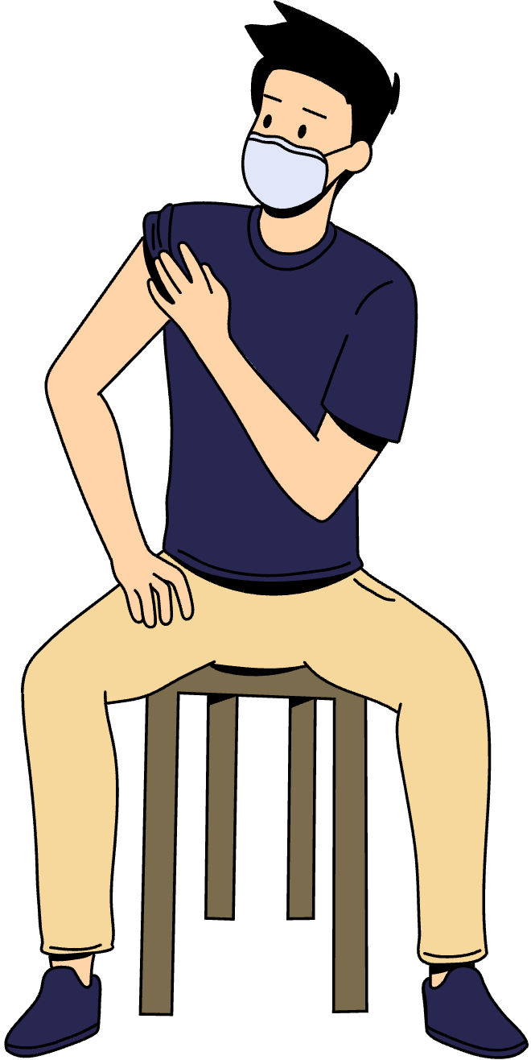
Designing A Healthcare Information System For Clayton State University Health Services That Facilitates Access To Student Health Information With Student’s Consent
By: Tychira Brown
Special Project
November 19, 2025

Slide 2


CONTENTS
Introduction
Background & Problem Statement
Research Objectives & Question
Research Methods
Functional Requirements
Non-Functional Requirements
System Architecture & Design
Implementation Timeline & Conclusions
References

Slide 3


INTRODUCTION
Project Objective
Develop a secure and efficient system connecting Clayton State University Health Services, GRITS, and Atrium Health to get access student immunization record access.
Institutional Context
Clayton State University faces manual consent and data retrieval challenges due to disconnected health and academic systems.
Research Approach
A qualitative study identifying interoperability gaps, privacy requirements, and system design needs through staff interviews and workflow analysis.
Notes:
GRITS - Georgia Immunization Registry Transactions and Services

Slide 4
Manual Consent Process
Students must physically visit the Atrium Health office to authorize immunization record access, creating restrictions during enrollment and orientation periods.
Administrative Burden
Due operate the various systems working independently with no direct interoperability or shared data framework.
System Fragmentation
Clayton State University’s Banner system, Atrium Health’s network, and GRITS operate independently.
BACKGROUND & PROBLEM STATEMENT

Slide 5

RESEARCH OBJECTIVES & QUESTION
Primary Objective
Research Question
Design a secure, consent-based healthcare information system to facilitate data exchange between Clayton State University Health Services, GRITS, and Atrium Health.
What are the functional and non-functional requirements for designing a health care information system for sharing student immunization records securely?

Slide 6


RESEARCH METHOD
Qualitative Framework
The study used a qualitative approach by conducting semi-structured interviews to explore system challenges and requirements among Atrium Health staff.
Data Collection
Interview questions focused on operational inefficiencies, consent management, and desired features of an integrated healthcare system.
Ethical Considerations
Confidentiality and informed consent were prioritized, ensuring compliance with institutional ethics and data protection standards.

Slide 7
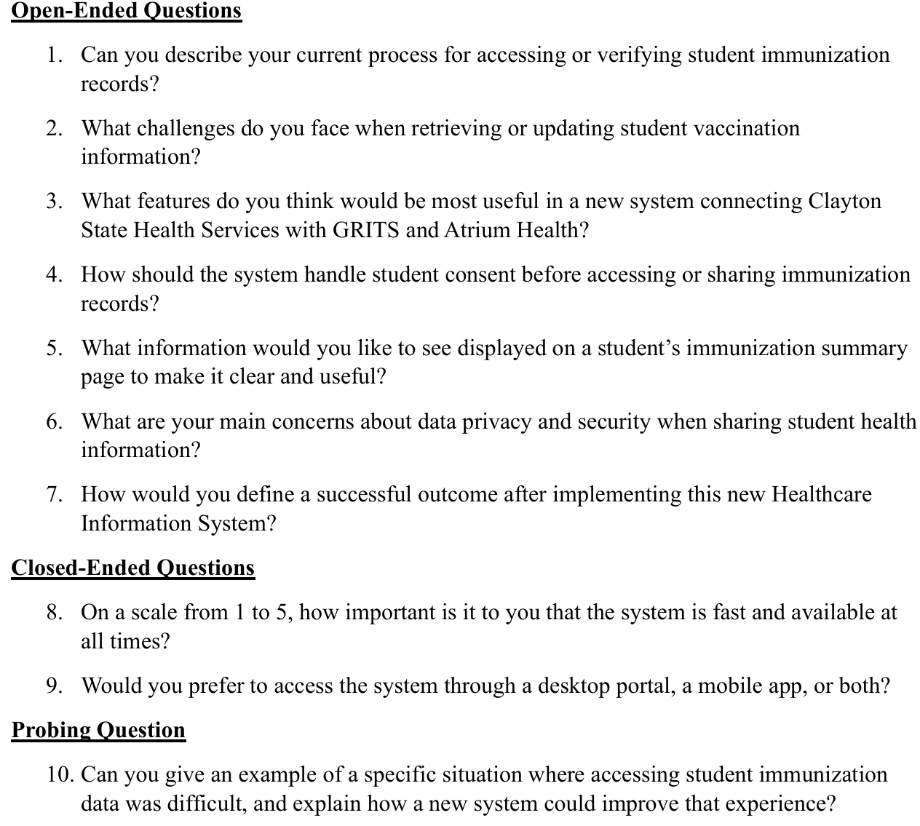
SYSTEM ARCHITECTURE & DESIGN
Interview Questions

Slide 8
FUNCTIONAL REQUIREMENTS
Electronic Consent Management
Students can submit, manage, and revoke consent forms electronically, authorizing data sharing between GRITS, Atrium Health, and the university.
User Authentication and Roles
All users, including students, staff, and administrators, must authenticate through secure logins with role-based access controls.
Real-Time Data Linking
When consent is confirmed, GRITS data is automatically linked to the student’s record in the Atrium Health system.
Automated Data Retrieval
Authorized staff can request and retrieve validated immunization data directly from GRITS through a secure interface.

Slide 9
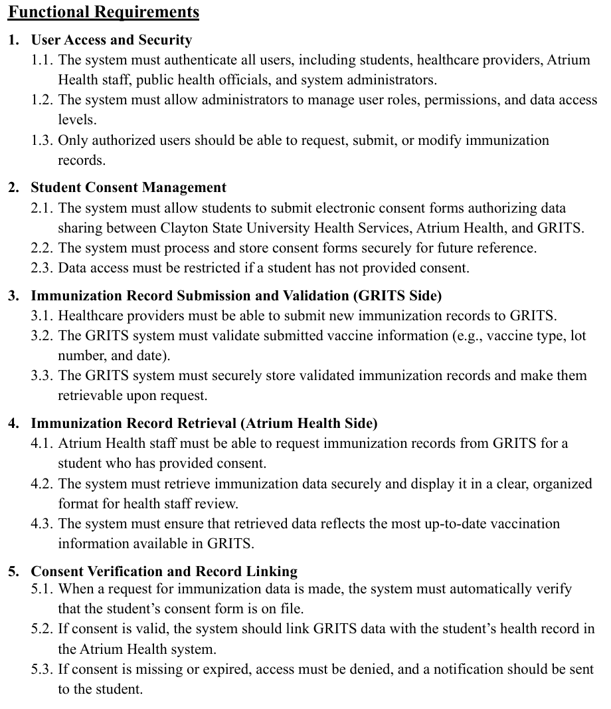
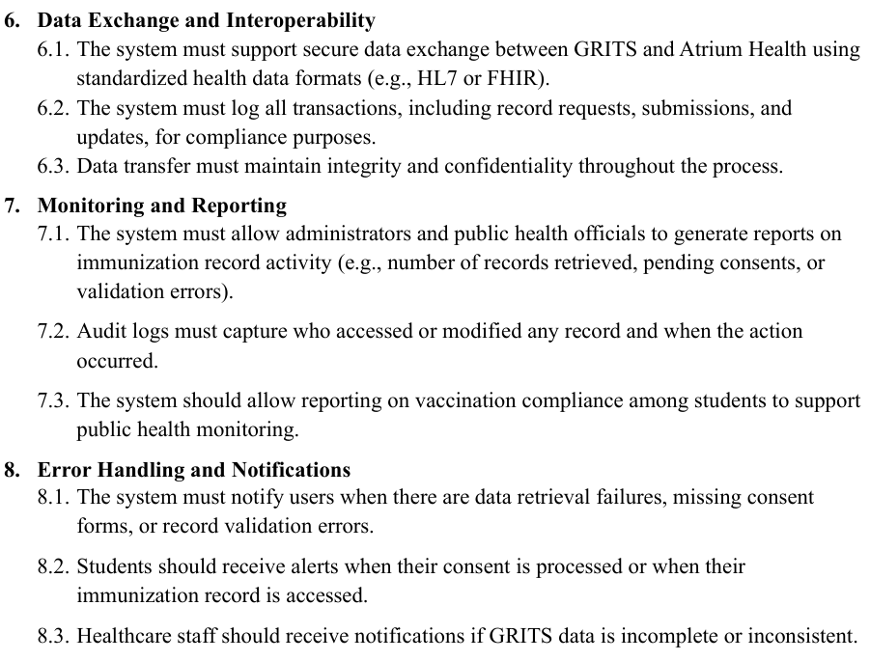
SYSTEM ARCHITECTURE & DESIGN

Slide 10
NON-FUNCTIONAL REQUIREMENTS
Performance and Reliability
System must achieve 99.9% uptime, retrieve data within five seconds, and support at least 500 concurrent users without degradation.
Security and Compliance
Full compliance with HIPAA with multi-factor authentication.
Usability and Scalability
Interface should require minimal training, while allowing easy expansion to accommodate future institutional growth.
Audit and Monitoring
Comprehensive audit logs must record all data access, retrievals, and updates for accountability and system transparency.

Slide 11
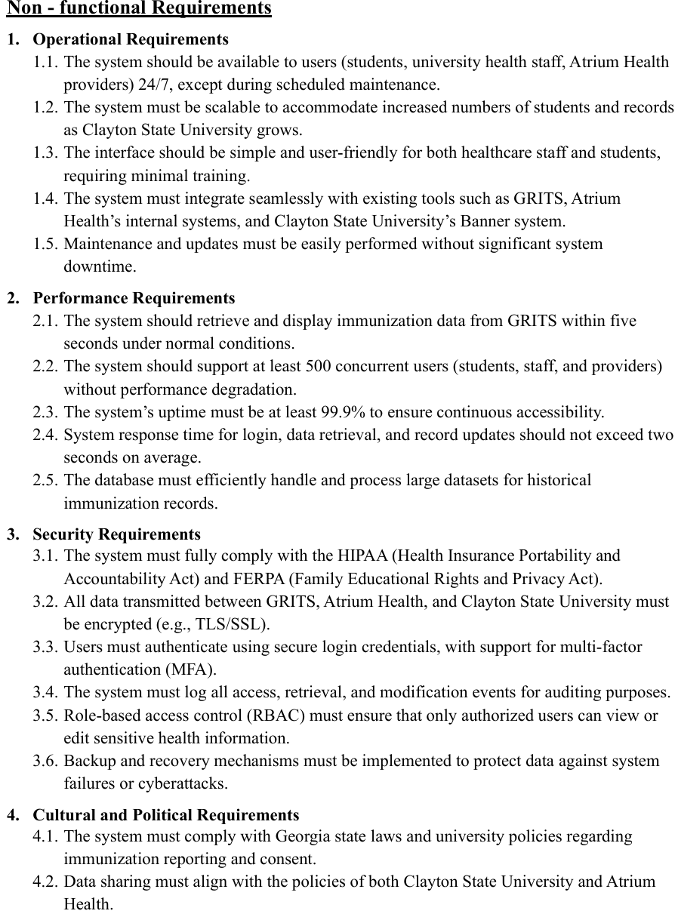

SYSTEM ARCHITECTURE & DESIGN

Slide 12
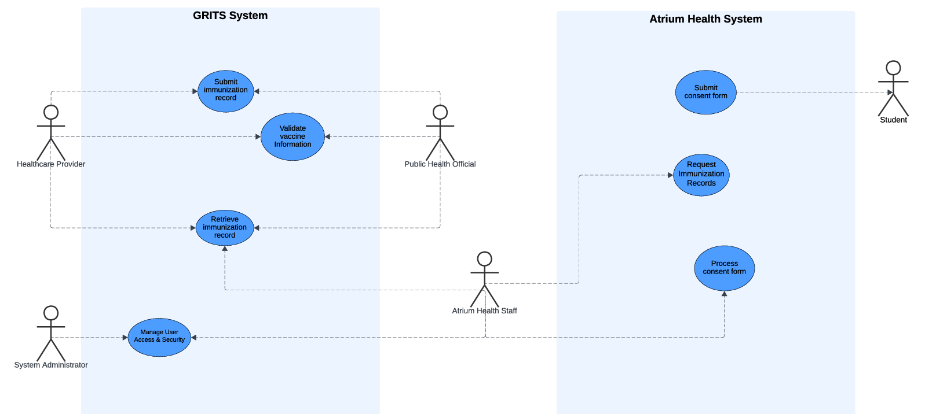
SYSTEM ARCHITECTURE & DESIGN

Slide 13
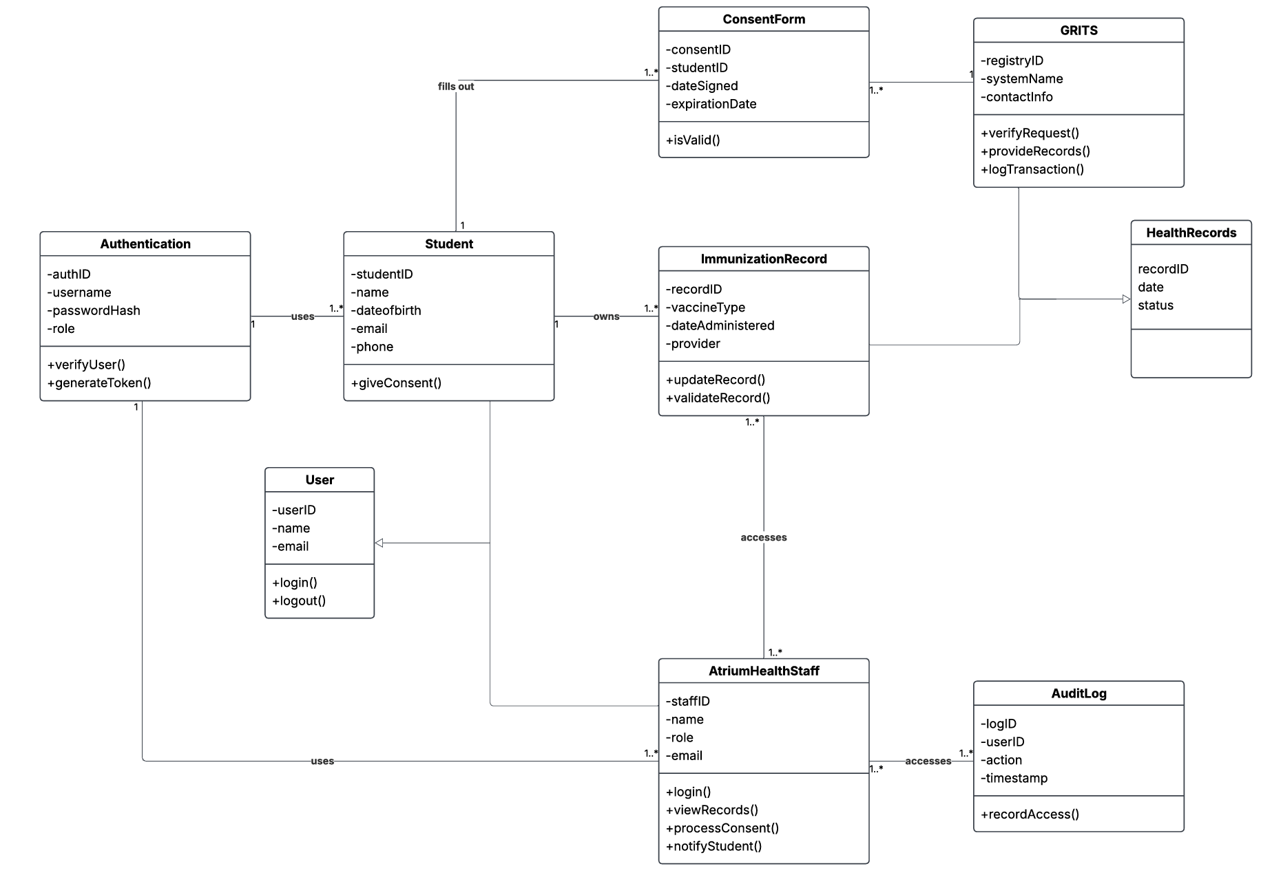
SYSTEM ARCHITECTURE & DESIGN

Slide 14
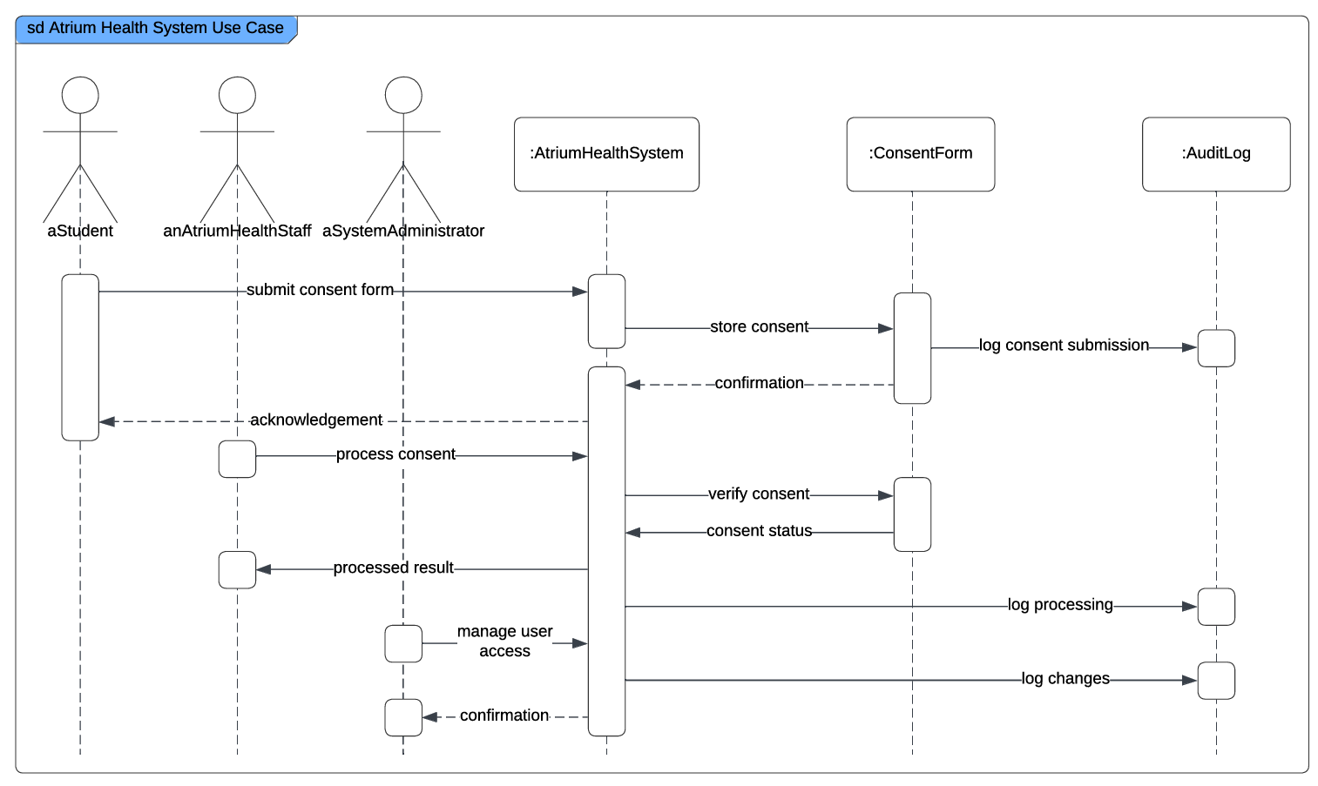
SYSTEM ARCHITECTURE & DESIGN

Slide 15
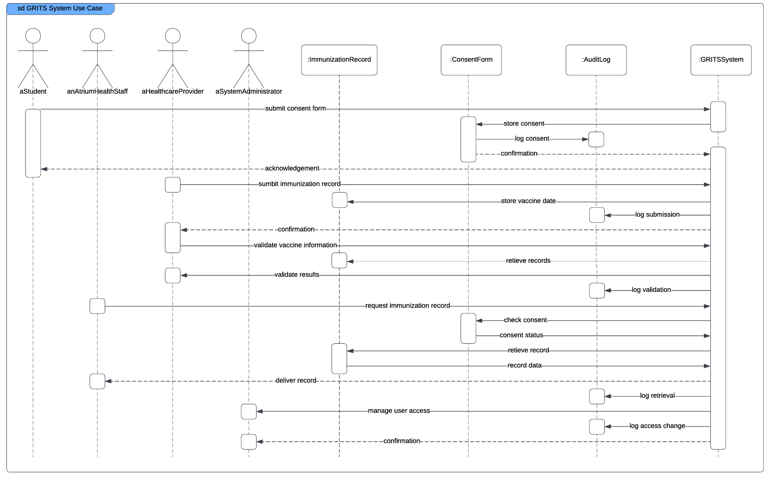
SYSTEM ARCHITECTURE & DESIGN

Slide 16
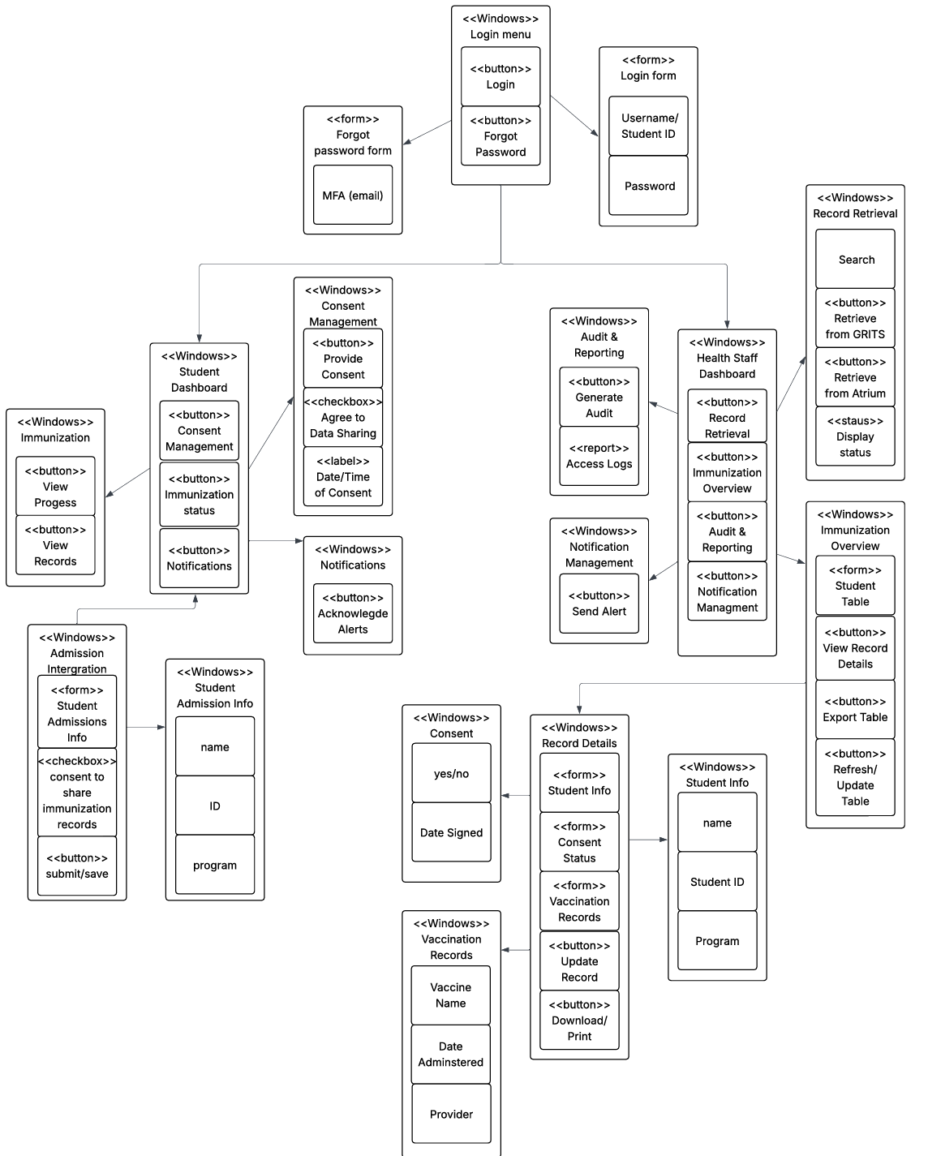
SYSTEM ARCHITECTURE & DESIGN

Slide 17
Project Timeline
Spanning October 2024 to November 2025, the project progressed through research, interviews, system modeling, and final design completion.
Institutional Benefits
Automation reduces manual consent handling, improves compliance verification, and enhances communication between GRITS, Atrium Health, and CSU.
Future Directions
Next steps include system prototyping, performance evaluation, and potential expansion to other universities across Georgia.
Conclusion
The proposed system transforms fragmented processes into a cohesive, secure network enhancing health record accessibility and student well-being.
IMPLEMENTATION TIMELINE & CONCLUSIONS

Slide 18

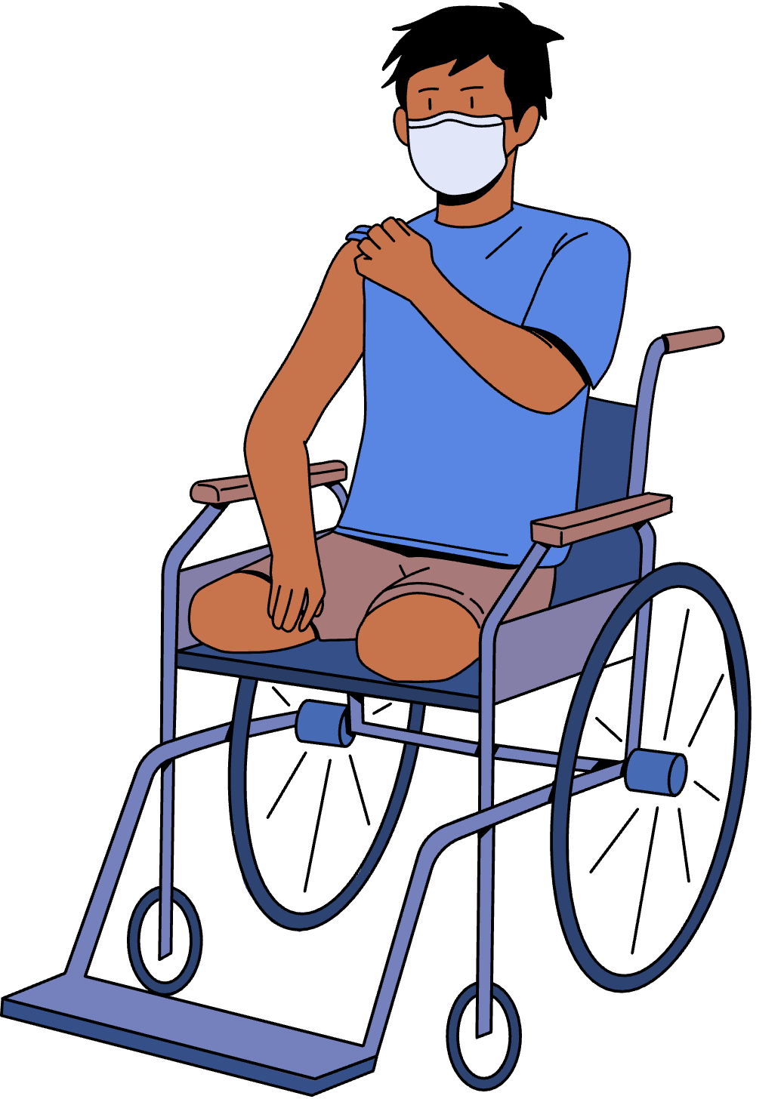
REFERENCES
Canavan, B. C., Kurilo, M., Moss, T., McLaren, R., & E. al. (2006). Immunization information systems progress-United States, 2005. Center for Disease Control Prevention. https://www.proquest.com/reports/immunization-informationsystemsprogressunited/docview/203773125/se-2
Georgia Department of Public Health. (2025). Georgia Immunization Registry (GRITS).https://dph.georgia.gov/immunizations/providers-and-healthcare/georgia-immunizationregistry-grits
University System of Georgia. (n.d.). Board of Regents policy manual: Section 4.2 -Admission policies. https://usg.edu/policymanual/section4/C334

